Slide 1


Stock Market Technical Analysis
A Data-Oriented Analysis
Steven Miller

Slide 2
Technical Analysis
Technical analysis is the use of formulas based on the price and volume of a stock to gain more information about the potential movement of the stock.
Some traders swear by technical analysis and use it build trading algorithms.
Others feel it is as useful as reading tea leaves or astrology

Slide 3
Project Scope
Using historical stock market data for 100 stock tickers, the Simple Moving Average crossover strategy will be analyzed.
Stocks are grouped into stationary or non-stationary buckets based on their time series. Only non-stationary stocks will be used in the final analysis.
Performance metrics:
Sharpe Ratio
Calmar Ratio
Sortino Ratio
All three metrics use some form of comparing the returns of a strategy to the risk incurred by it.

Slide 4
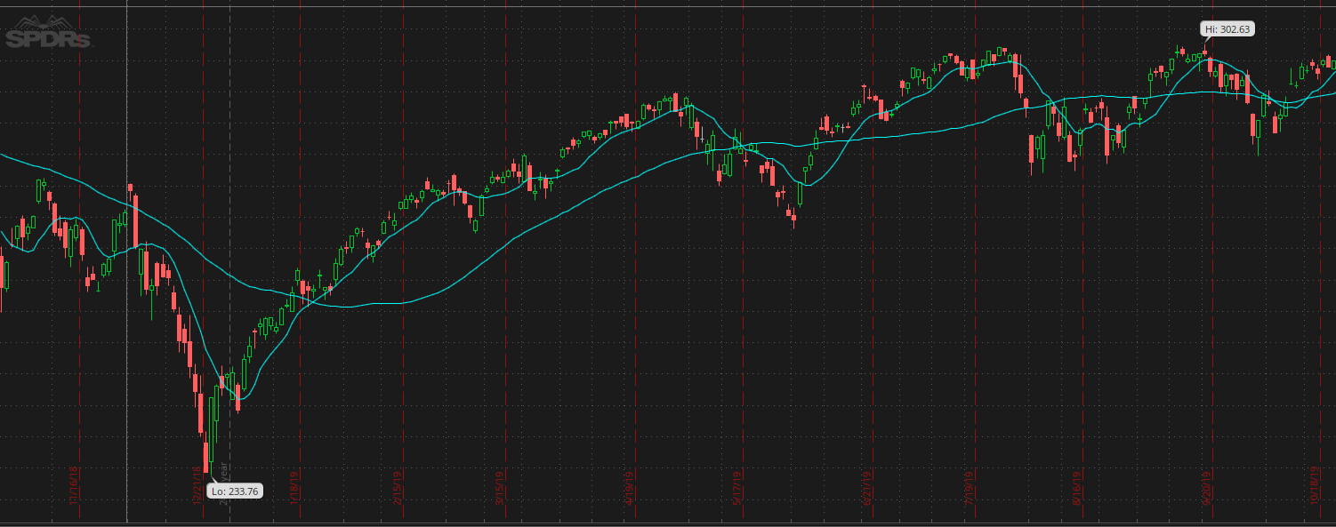
Simple Moving Average Crossover
Four numeric values are used for this strategy:
Short term entry point
Long term entry point
Short term exit point
Long term exit point
Strategy uses a short and long-term moving average. When the short-term average rises above the long-term average, a BUY signal is generated. When the short-term exit average drops below the long-term exit, a SELL order is generated.
This strategy will be tested across all 100 stock tickers using values ranging from 5 to 200 in 5-day increments for all four variables.
This graph depicts the S&P 500 price movement along with a 10-day and 30-day moving average. In this example we would buy the index fund when the 10-day average exceeds the 30-day average, and sell when the 10-day average drops below the 30-day average

Slide 5
Model Building
Once all testing has been completed, the performance across all tickers in consideration will be evaluated on the previously mentioned criteria.
Sets of values that indicate better returns than merely buying and holding a stock will be included in a classification model. For classification purposes, 1 will indicate a good buy signal, 0 will indicate no buy signal.
If feasible, a random forest classifier will be used for the building of the model.

Slide 6
Project Challenges
Building a database
Due to the amount of data being worked with, it made sense to create a better structure than simply having a bunch of CSV files in a folder. A PostgreSQL database was created to handle all of the data as well as the results of each test.
Backtesting stock data
Many stock backtesting libraries exist for Python, it took some time to find the library best suited for this project. An additional library was needed for the purpose of generating technical analysis indicators.
Computing Time
The sheer number of tests being run (over 100 million) has led to longer computing time than initially anticipated. As a result, the initial plan of testing many technical analysis indicators had to be scaled back.

Slide 7
Adaptations to Challenges
Testing time
While I investigated ETL packages that might make it easier to queue jobs up for processing, the setup time for this project didn’t seem to be a good use. Instead, numerous jobs have been run simultaneously to take advantage of multicore processing. Further optimization could likely be made moving forward.
Modularity
By storing all test results in a database table that’s adaptable to any trading strategy, additional technical analysis strategies can be generated moving forward and easily included into future models if they are found to show promise.

Slide 8
Future Plans
Once all testing has been completed, the results can be aggregated. Each strategy can then be analyzed for inclusion into a classification model.
Once the model has been built it will be trained on most of the data gathered. Evaluation will take place on the most recent two years of data, which has been excluded from the training phase.
The model will be evaluated on traditional metrics as well as its ability to generate a profit through trading over time.

